Slide 1
Group members :
SANKAR SETHI (18EE007)
PLABIN BISI (18ECE125)
SOUMYA RANJAN SAHOO (18EEE008)
PRASHANT KUMAR SHARMA (18CSE049)
SIMRAN KUMARI (18CSE064)

Slide 2
PROBLEM
DIFFICULTIES FACED BY DUMB PEOPLE IN COMMUNICATION WITH OTHERS.
PATIENTS ON BED REST FACE DIFFICULTIES IN COMMUNICATING FOR THEIR BASIC NEEDS.
TOO OLD PEOPLE WHO DEPENDS ON OTHERS FOR THEIR BASIC ACTIVITIES.

Slide 3
statistics

Slide 4
SOLUTION SMART GLOVE
SPEAK WITH YOUR FINGER TIPS.
QUICK RESPONSE.
MAKE LIFE EASY FOR NEEDY.

Slide 5
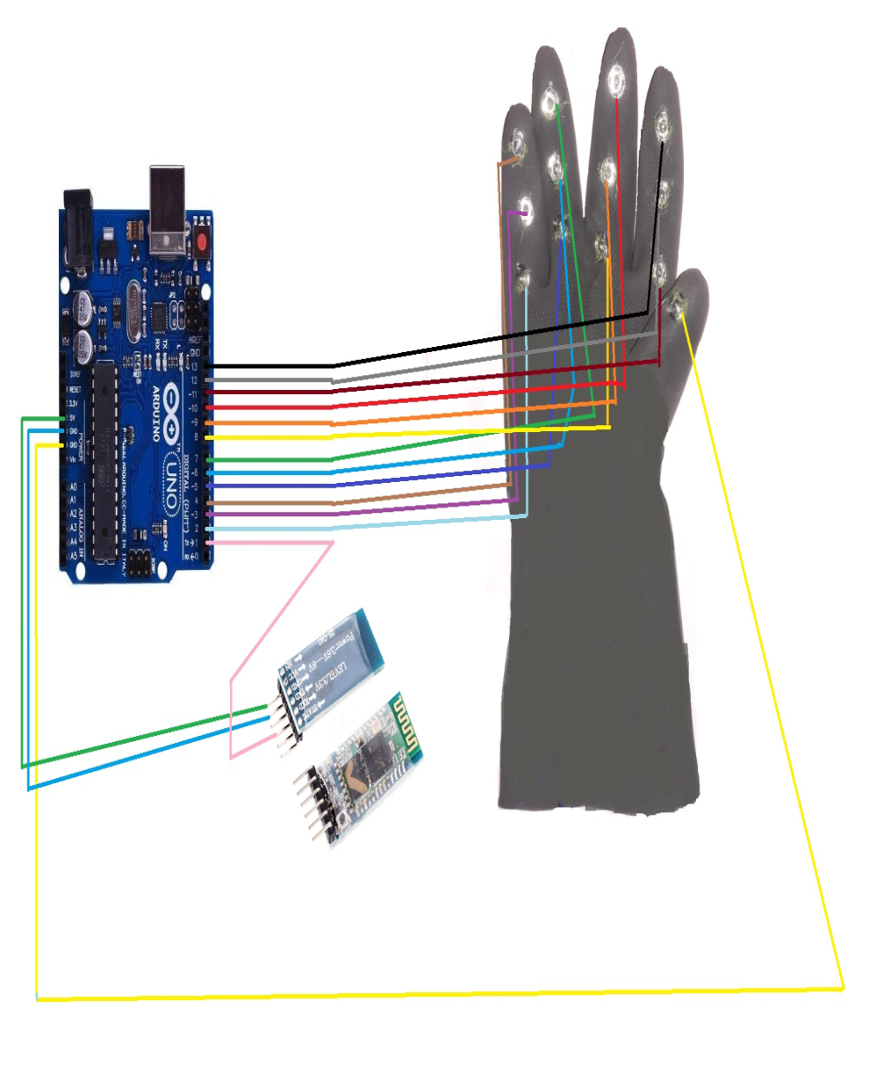
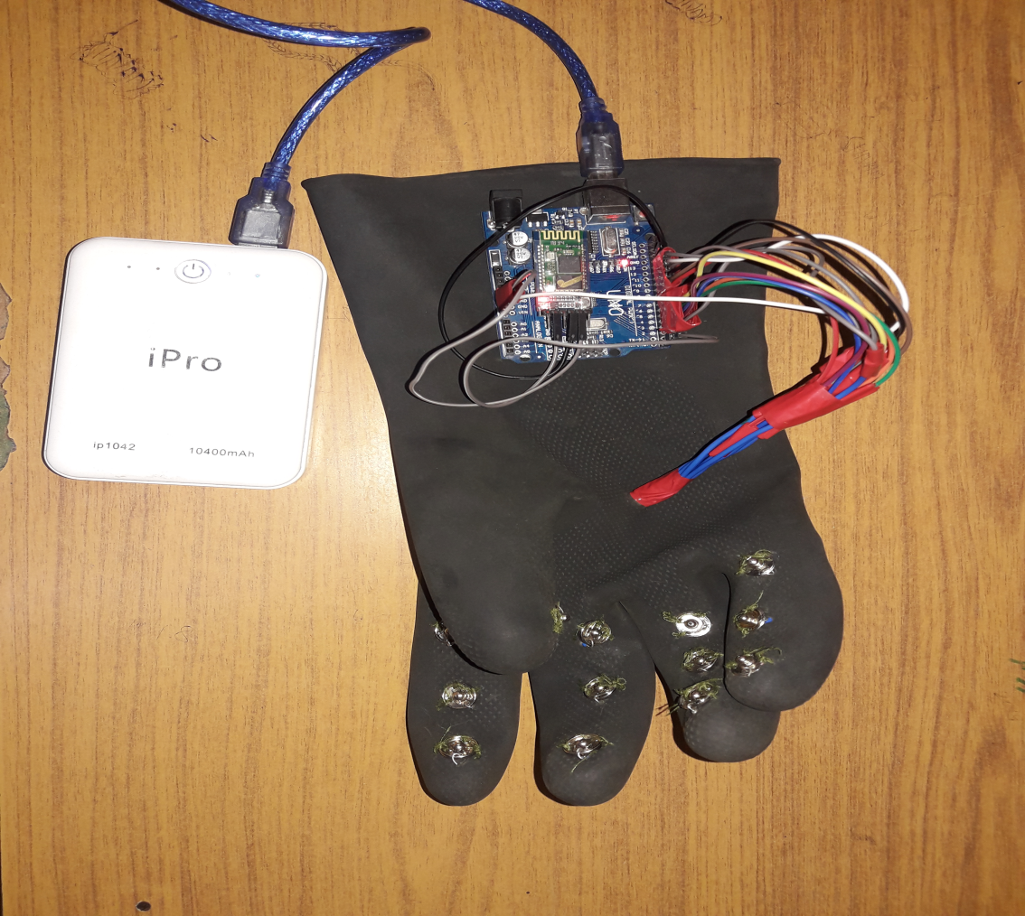
HARDWARE VIEW
SYSTAMATIC REPESENTATION

Slide 6
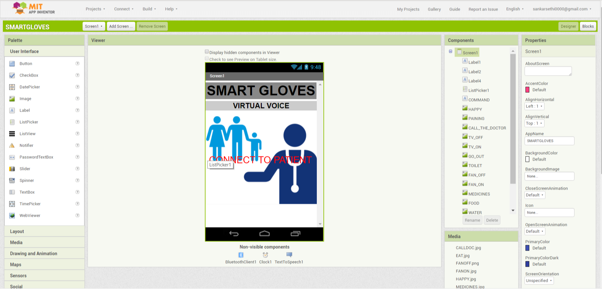
CONTROLLED BY AN APP

Slide 7




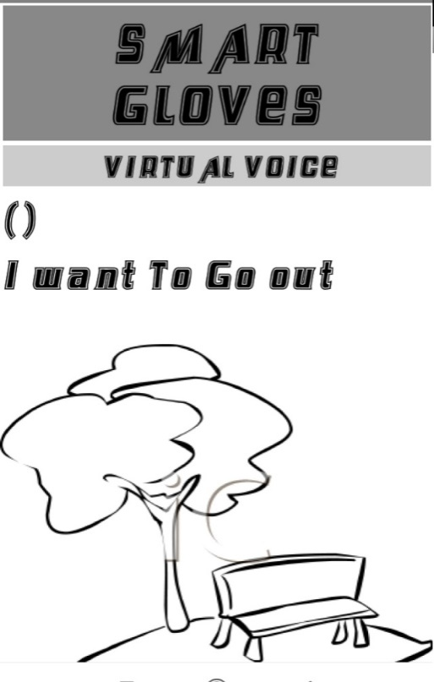


CAN SET DIFFERENT ACTIVITIES

Slide 8
MARKET PLANS
BOON FOR DISABLED
VERY EFFECTIVE FOR PEOPLE ON BED REST
ALSO USEFUL FOR OLD PEOPLE

Slide 9
COST PER UNIT
S.N | COMPONENT NAME | PRICE IN Rs
1 | ARDUINO UNO | 345
2 | BLUETOOTH MODULE | 355
3 | WIRES | 26
4 | BUTTONS | 7
5 | BATTERY | 20
6 | GLOVE | 55
 | TOTAL | 808
SALES : 899 Per unit(Rs)

